Slide 1
Unmanned Aerial Vehicle (UAV) Agricultural Drone
Muhammad Nazhan Bin Ramli
1816847

Slide 2
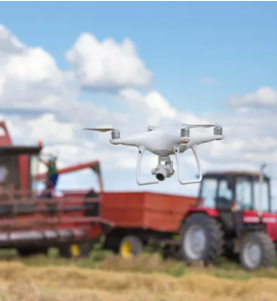
History of Agricultural Drones
The evidence about the first use of aerial vehicles dates back in 1921. The USDA, in collaboration with the US Army, deployed it for crop dusting at McCook Field (Dayton, Ohio). Aerial vehicles helped farmers again in 1939. The Royal New Zealand Air Force assisted with the spread of seeds, mixed with fertilizers. Nikola Tesla induced radio-waves in 1898, the technology took a long time to develop them RC-air planes and helicopters. The hobbyists took advantage of RC and transistor technology to fly models during the 1960s. Then helicopters entered the scene. A US farmer, Robert Seesholtz, hired helicopters to whip down warm air to protect strawberries from frost injury in 1978.
One probable evidence of using a partly un-maned vehicle for agriculture seeding comes from a New Zealander: John Chaytor. Chaytor used a hot air balloon steered with ropes from the ground. Then in 1970, Dr. Dieter Schlüter created a model RC-helicopter. However, the founder of drone technology is considered to be Abe Karem. He built the first fully functional drone for Israel in 1974 but not meant for agriculture. But, Israel has made significant developments in agriculture drones more recently.

Slide 3
History of Agricultural Drones : The Cameras
The first evidence of using a camera on a drone is reported on research by Thurling in 1985. In his research, he used one for for taking vertical images of weeds in an oilseed crop. Two years later, Yamaha demonstrated an R-50. It is considered to be the ever first UAV (Unmanned Aerial Vehicle) for dusting crops. Later in 1989, Yamaha introduced a commercial version of the R-50. Unfortunately, it had complicated handling and did not comply with international flying regulations.
The Swedish University of Agricultural Sciences took the lead in 1991 in developing a camera drone. It was used for taking observations on crop trials. Another development came from a Hungarian engineer Laslo Kiss who introduced a methanol-driven UAV that weighed 17 kg. Another claim for using a camera drone came from Dr. Anders Larsolle (SLU) in 1992 for studying late blight in potato. Drones used for the monitoring of climate data and environmental features in 1993.

Slide 4
Impact on 21st Century
The University of Bourgogne, France considered using RC- aircraft equipped with a camera to fetch agriculture field images in 2001. The concept of having a personal drone came to fruition in 2006 when these flying machines became flying cameras. But they were still out of reach of general user due to higher costs. Blair started developing a fixed-wing UAV in 2006 and operated in the same year.
In 2009, the Centre for Field Robotics developed a fixed-wing drone for a cattle farm in western Queensland, Australia. It monitored Weed infestation; later spraying the weeds with herbicide by a Quadcopter. They also used drones to detect locust swarms in the same facility. The Australian Almond Board used drones for crop estimation in 2013. Parrot, a French Technology company, induced its’ ready to fly Wi-Fi drone in 2010. It is the first-known smartphone-operated drone.

Slide 5
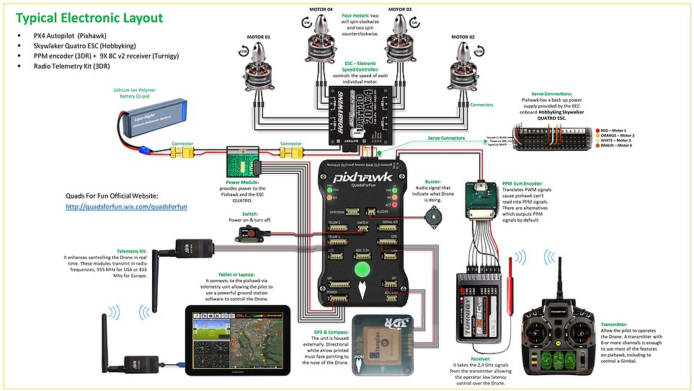
Basic System Architecture

Slide 6
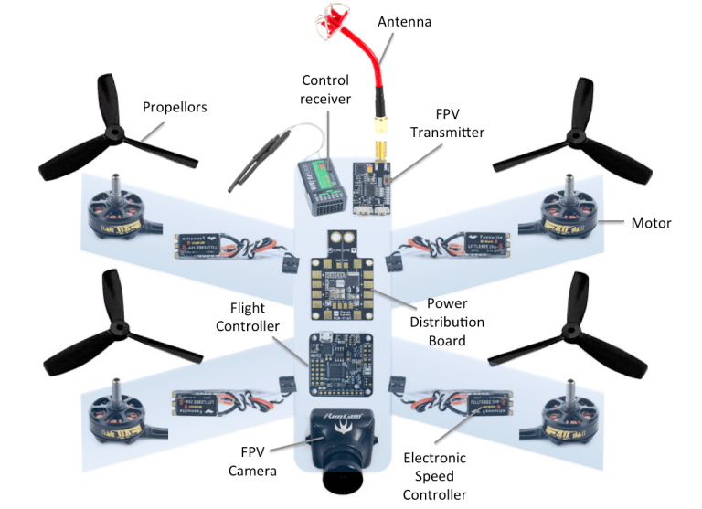

Slide 7
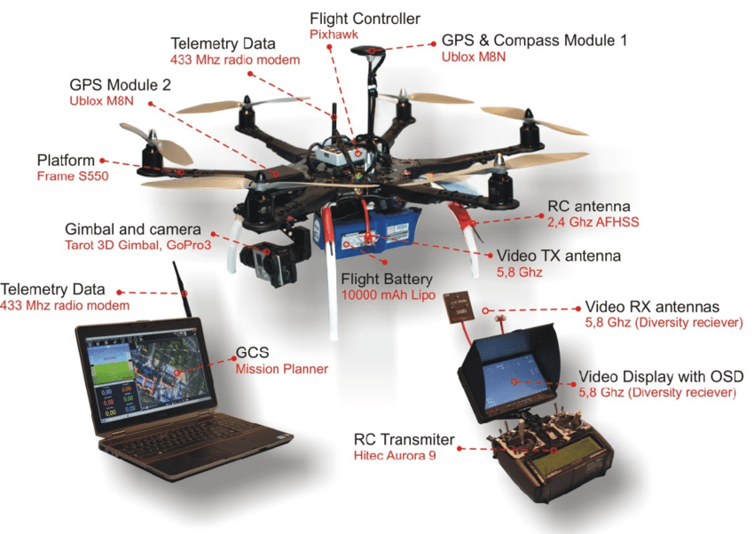

Slide 8
ROBOT DESIGN VS TASKS

Slide 9
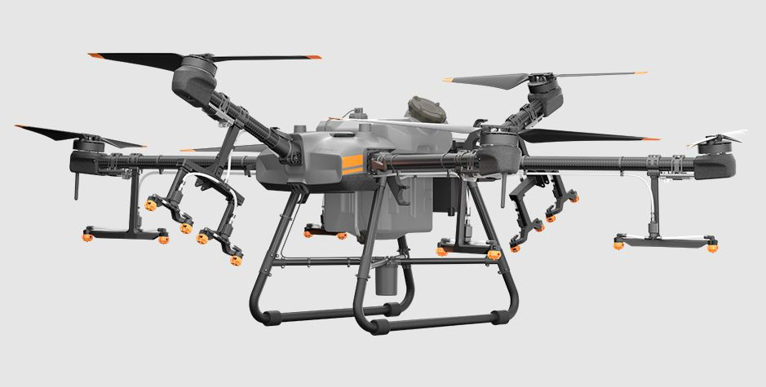
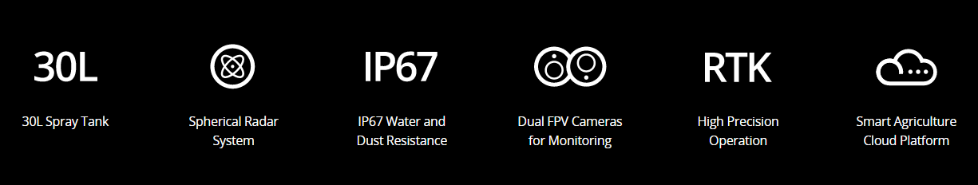
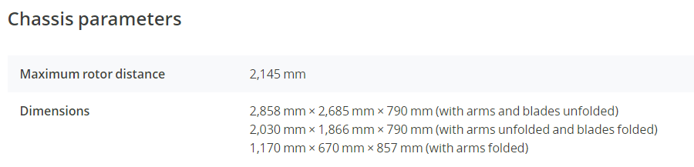
1) DJI Agras T30 (Hexacopter)
Aerial Spraying
With a 30 liter spraying tank, the DJI Agras T30 takes aerial spraying efficiency to new heights. A revolutionary transforming body enables more effective spraying, especially for fruit trees. Using DJI digital agriculture solutions, the T30 helps reduce fertilizer use and increase yield with effective, data-driven best practices.
Fuselage made of carbon fiber material

Slide 10
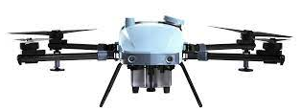
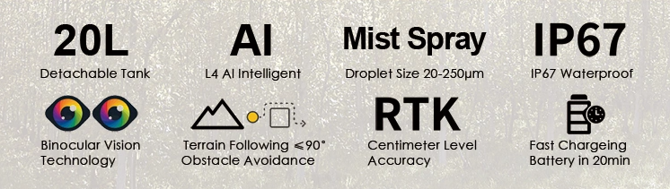
2) EA 2021 Drone (Quadcopter)
Aerial Spraying with AI
The new E-A2021 intelligent plant protection drone, launched in 2021, can realize automatic path planning and L4 autonomous flight, autonomous intelligent obstacle avoidance, and no survey required in complex environment. It is equipped with the world's first CCMS ambient temperature mist spray system and accurate flow control. Autonomous flight with low droplet drift on steep terrain, operating slope up to 90 degrees; super-high tree autonomous flight with low droplet drift, 10 meters drop barrier-free; global offline mode more suitable for operation in hills and mountains

Slide 11
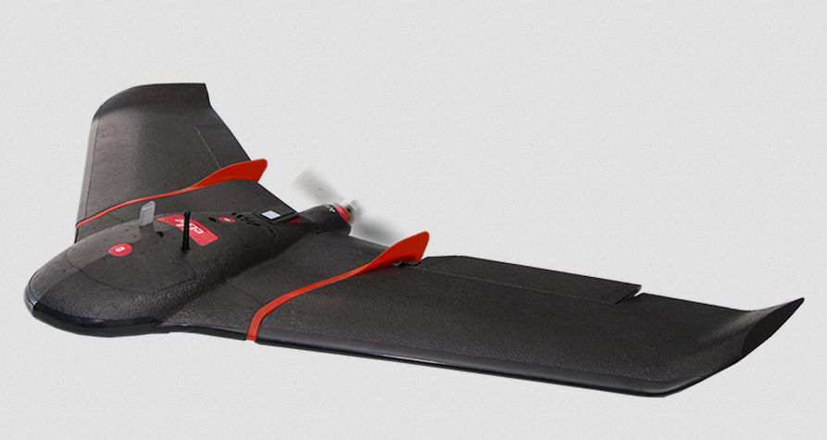
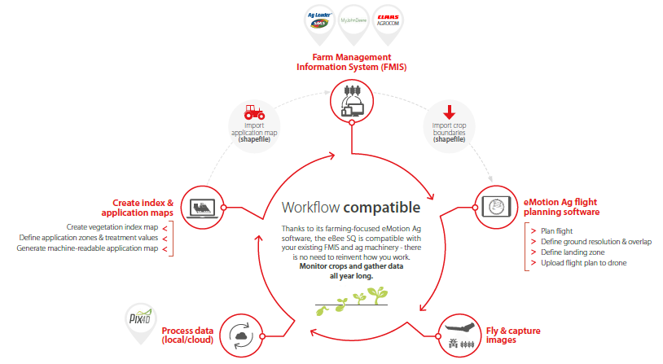
3) SenseFly eBee SQ
Precision Agriculture Drone and Data Processing Solutions
Fixed-wing agricultural robot
The drone offers agricultural intelligence solution that identifies areas of concern in the field and rapidly returns reliable health maps, tailored for agricultural applications such as a plant’s chlorophyll levels.

Slide 12
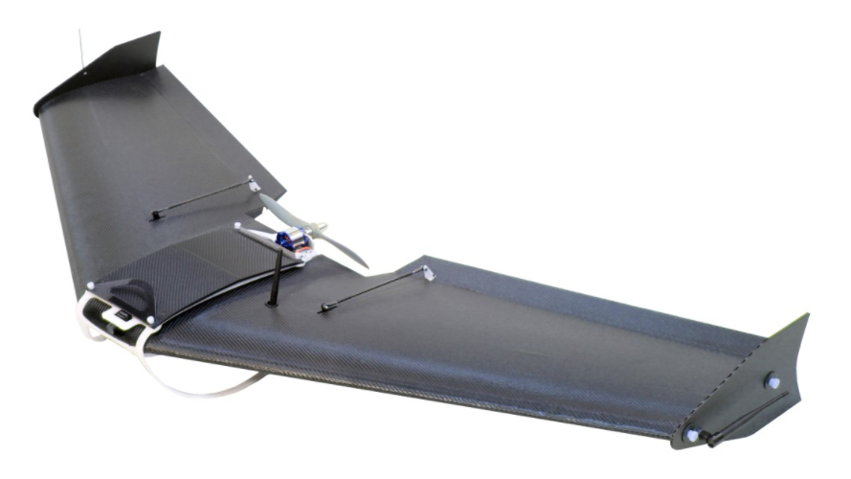
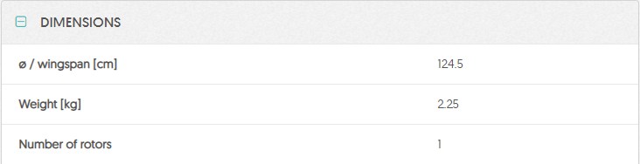
4) Honeycomb AG Drone
Scouting, mapping and analytics
Using aerial systems farmers, scouts, or ranchers can quickly survey large amounts of land and get a bird’s eye view in high resolution, detect areas of stress, and monitor irrigation systems.
Fixed-wing agricultural robot
Material : Kevlar Exoskeleton

Slide 13
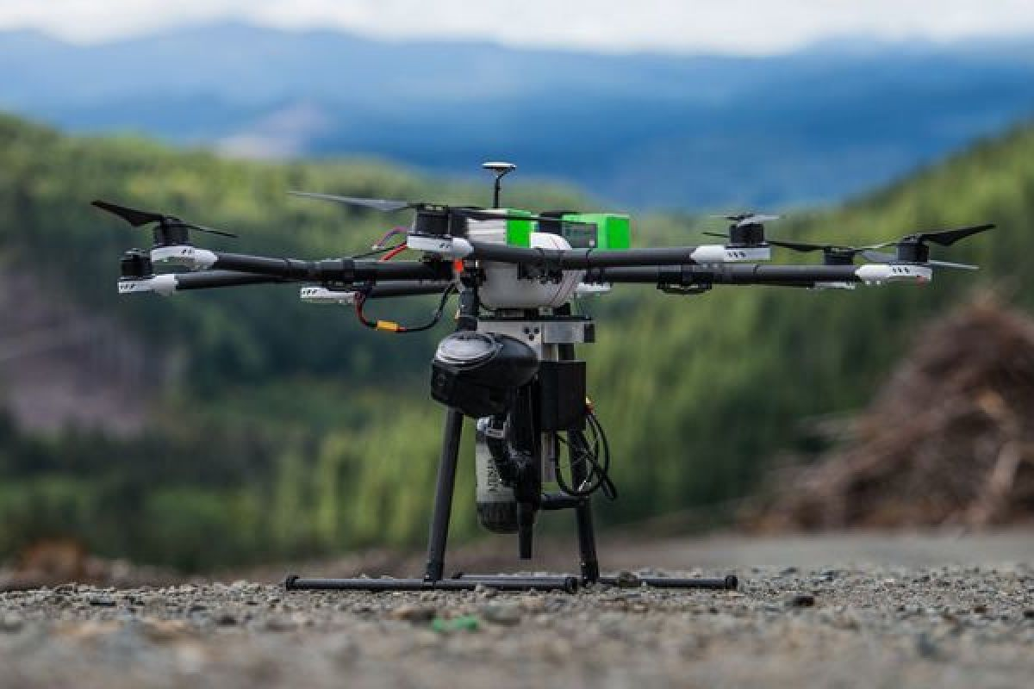
5) Drone Seed
Rapid Reforestation
Droneseed is a Seattle-based startup that envisions a future where technology is solving our planet’s deforestation problems.

Slide 14
ACTUATORS & LOCOMOTIONS

Slide 15
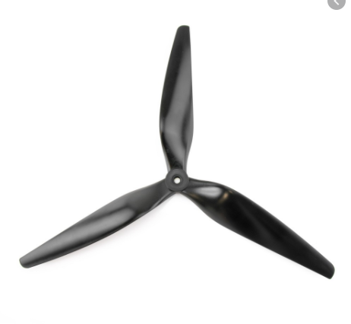
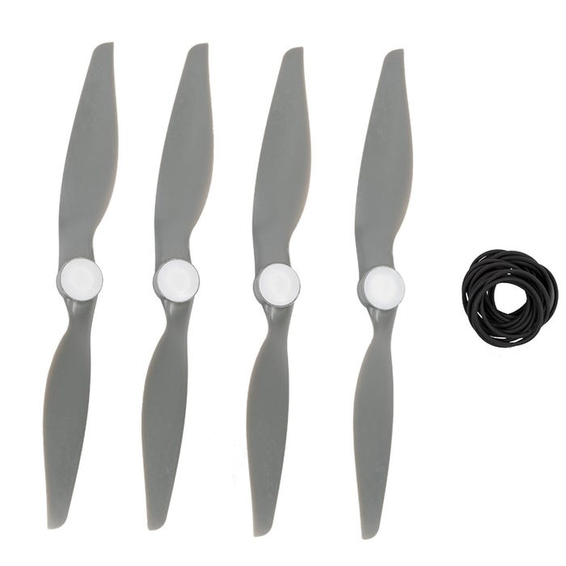
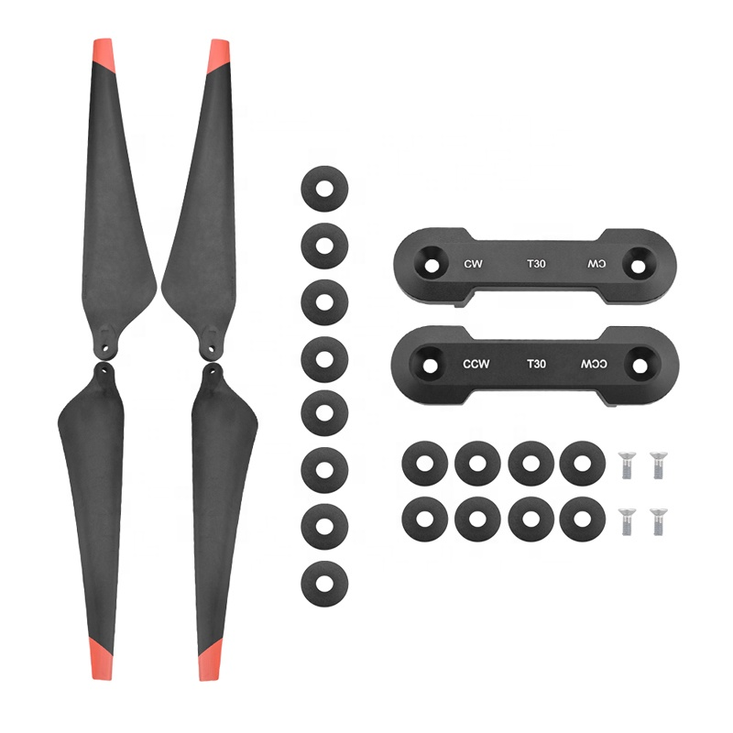
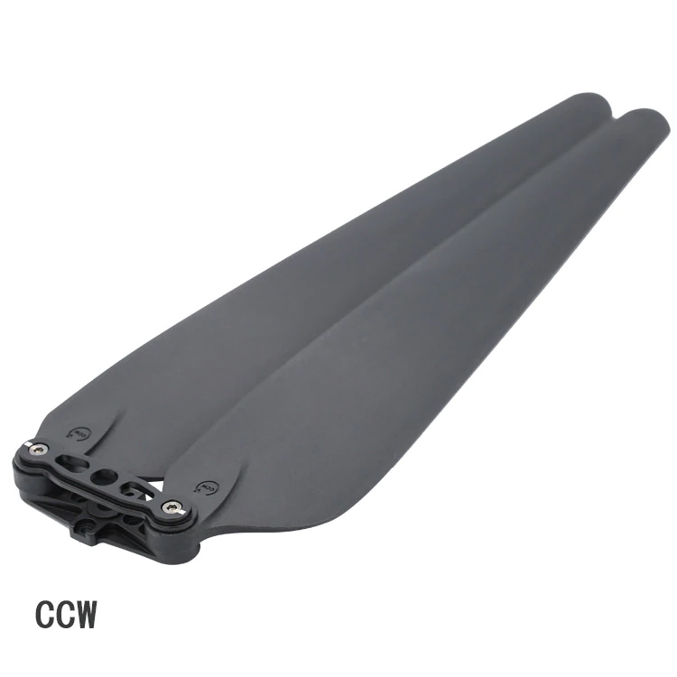
1) Propellers

Slide 16
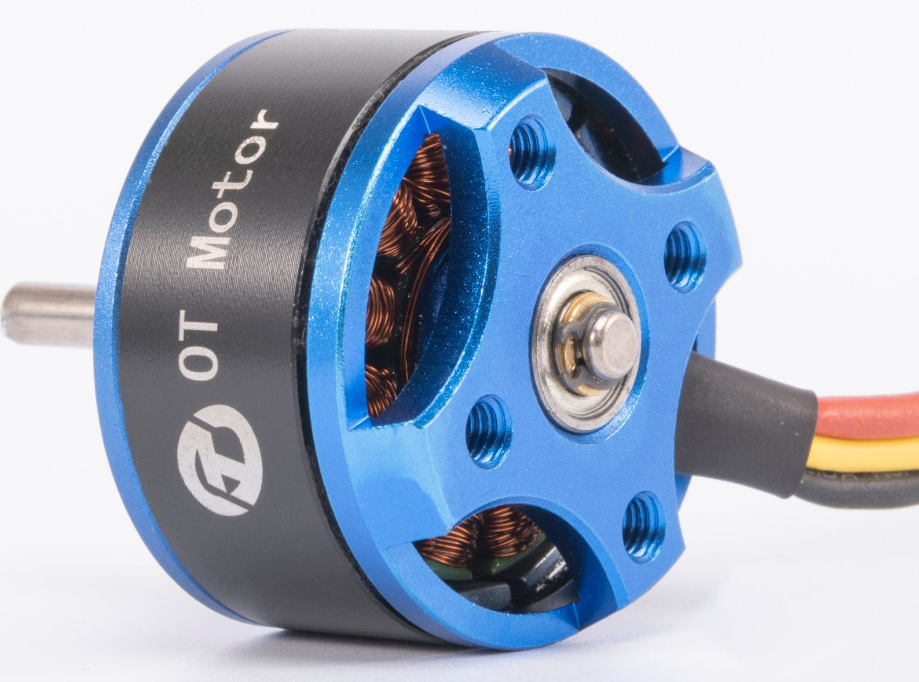
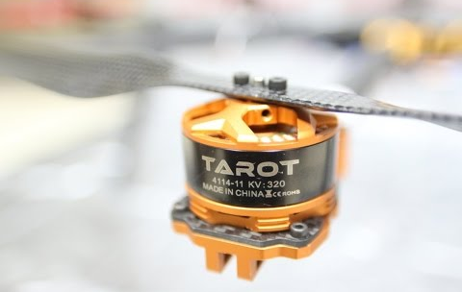
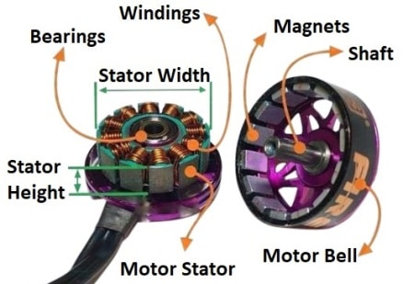
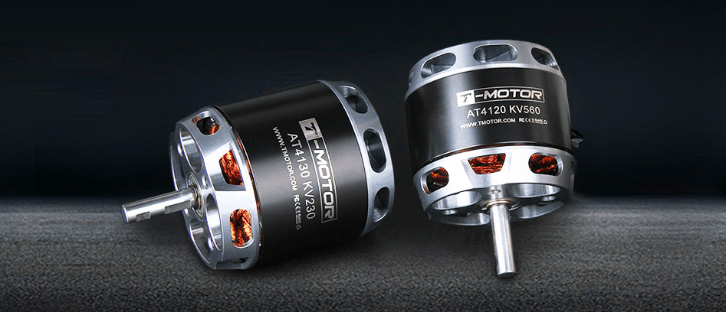
2) Drone Motors

Slide 17
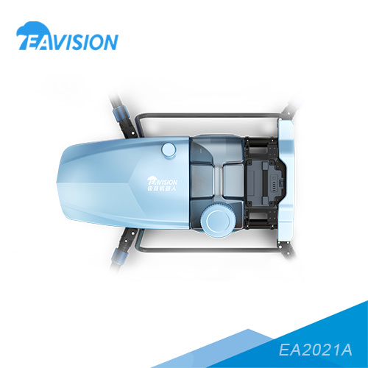
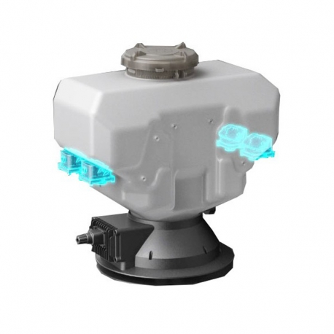
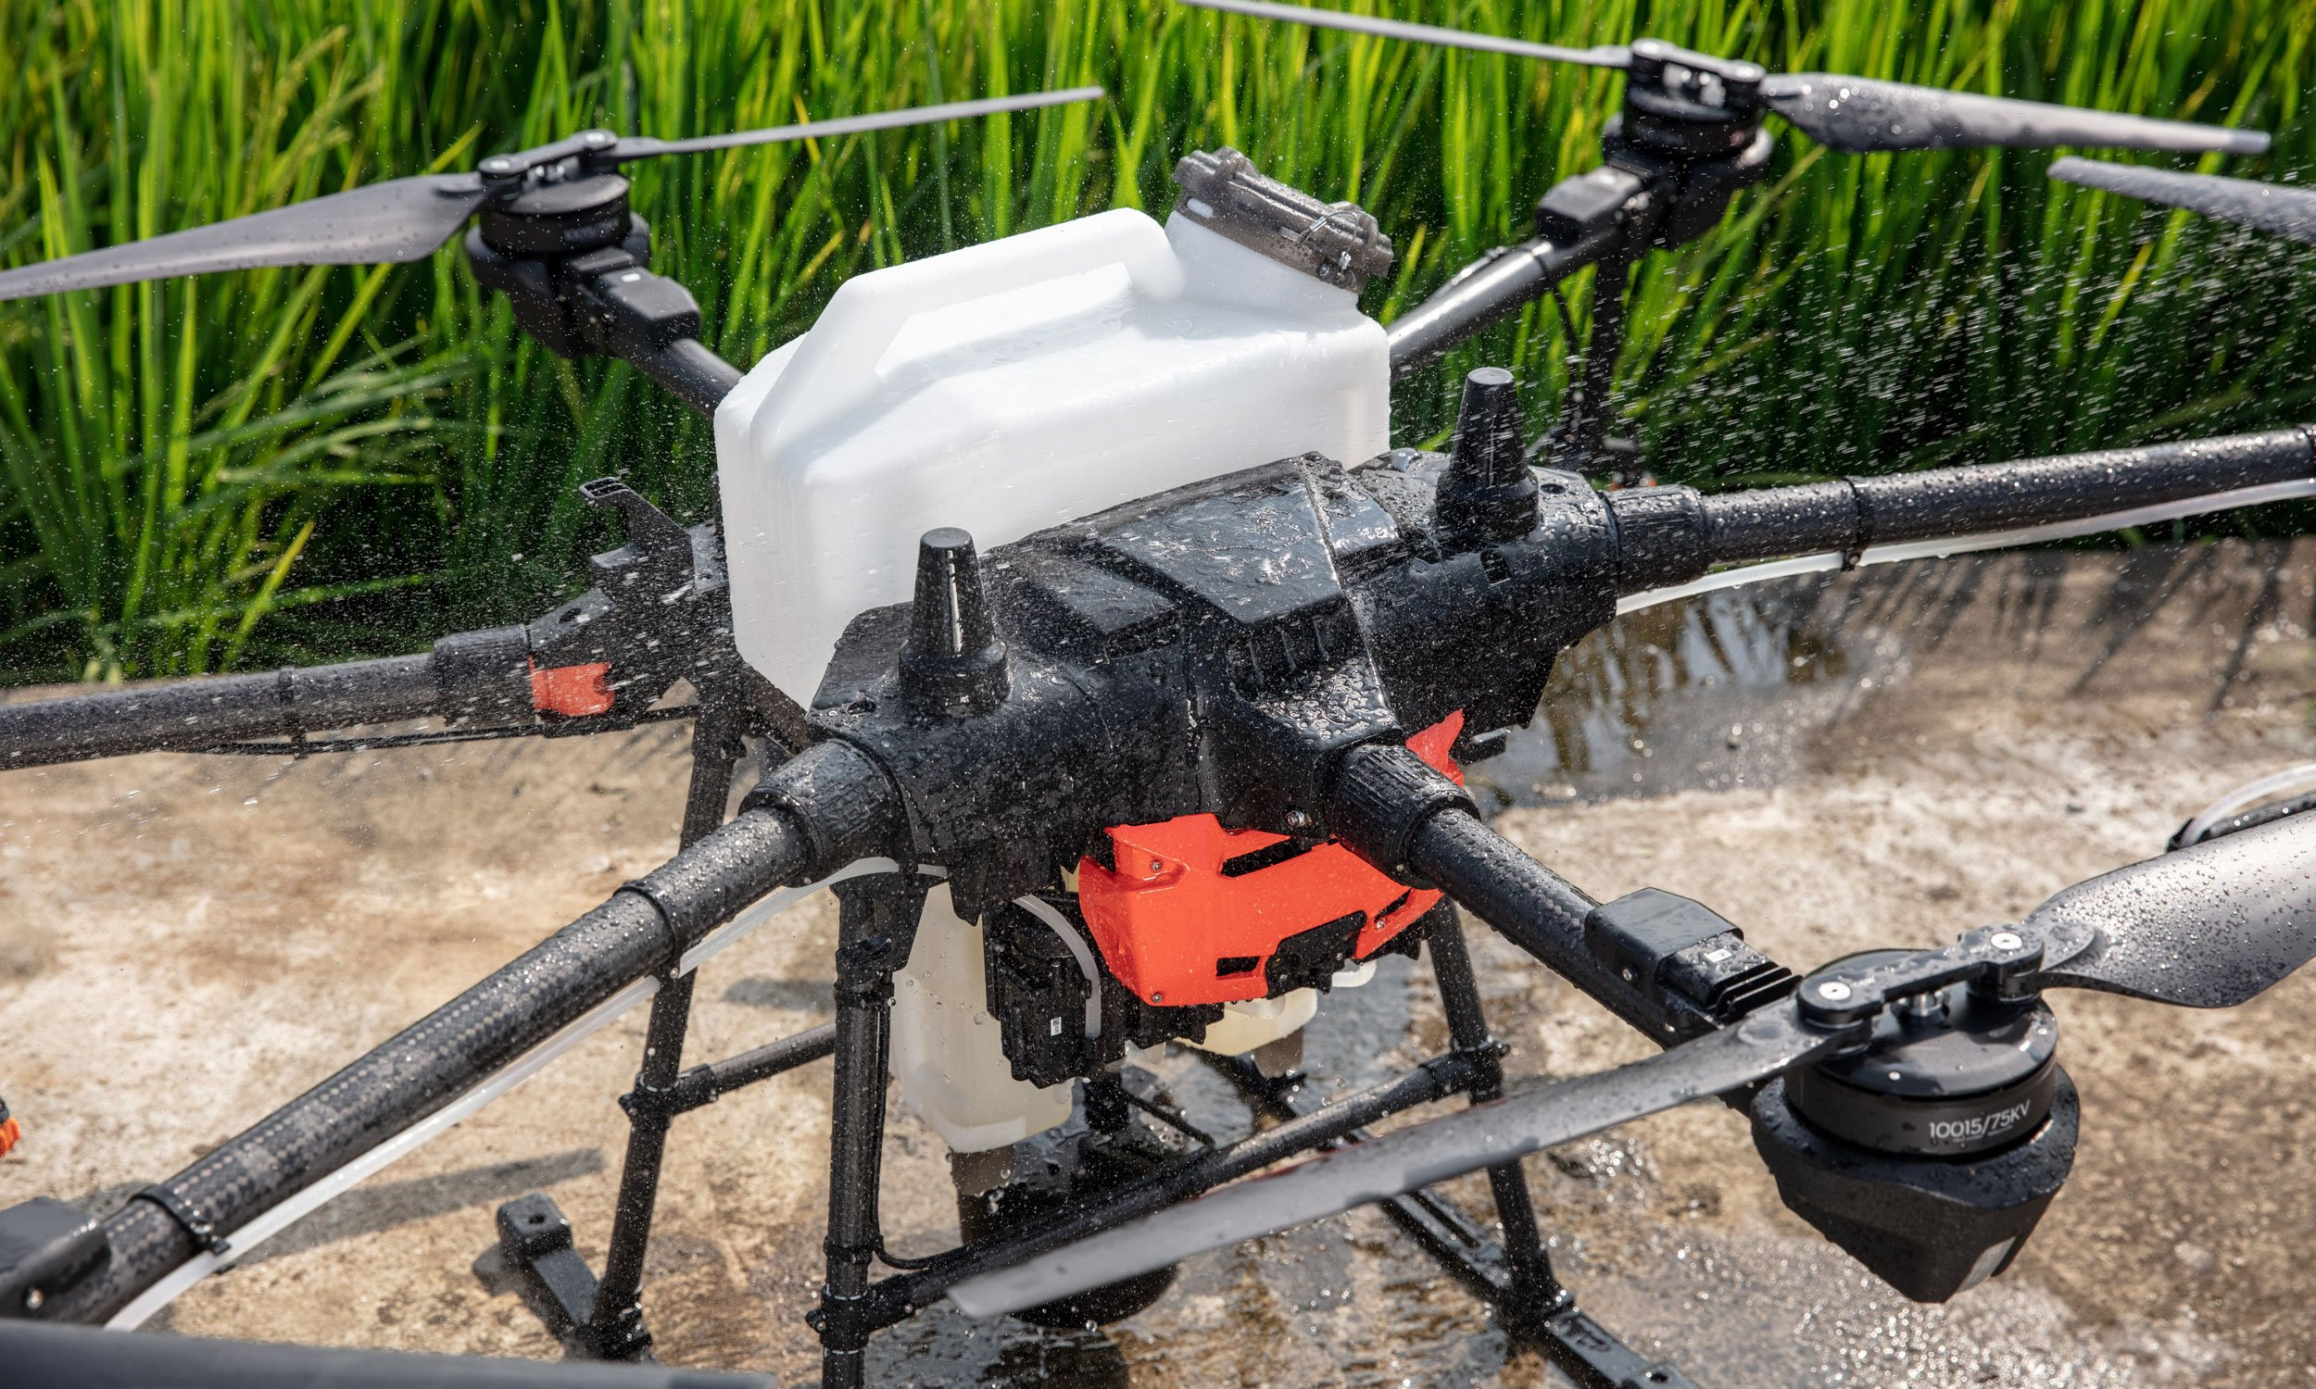
3) Spraying System - Operation Tank
The operation tank is used to store pesticides

Slide 18
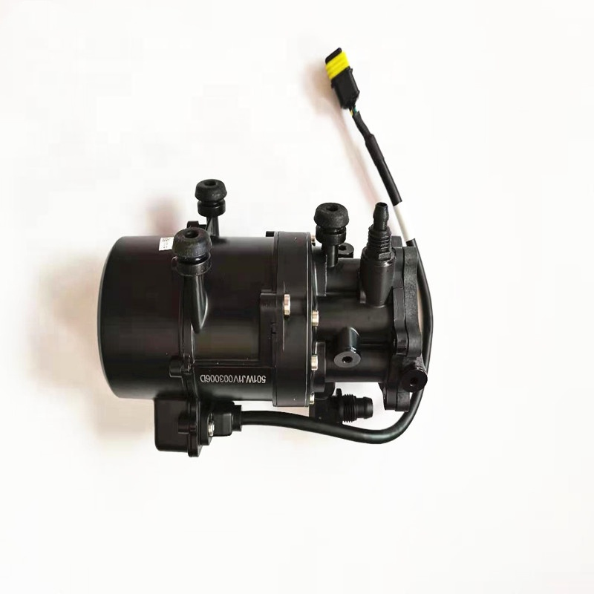
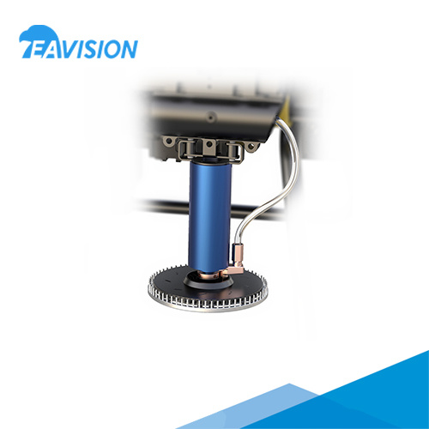
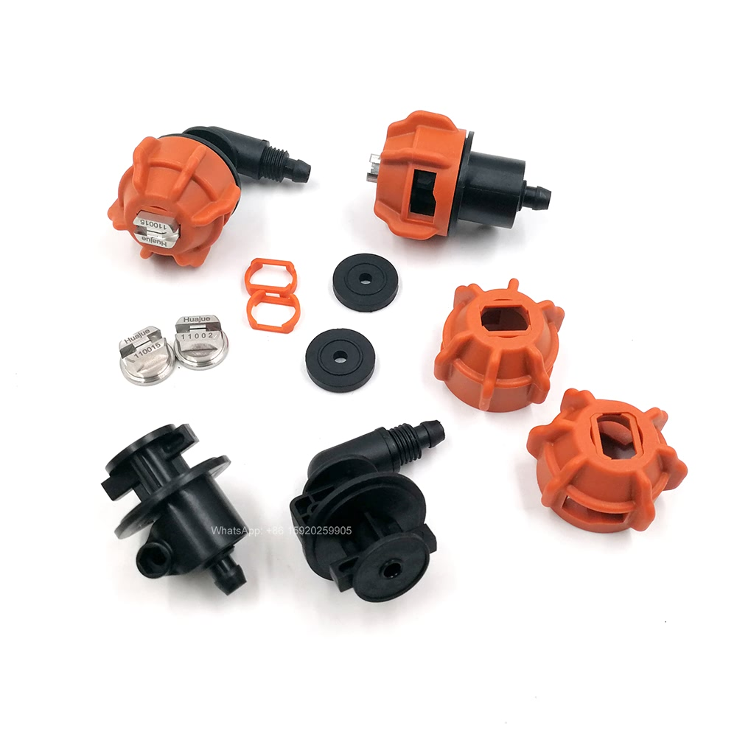
4) Spraying System - Water Pump & Nozzles
Plunger pump
Mist nozzle
Mist spray

Slide 19
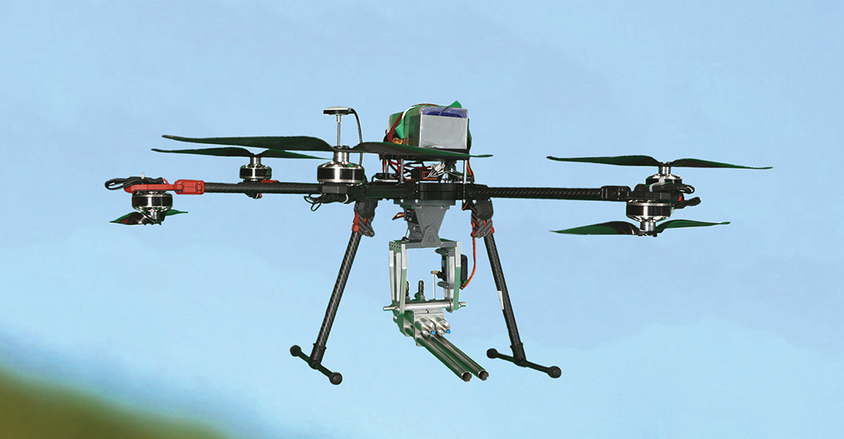
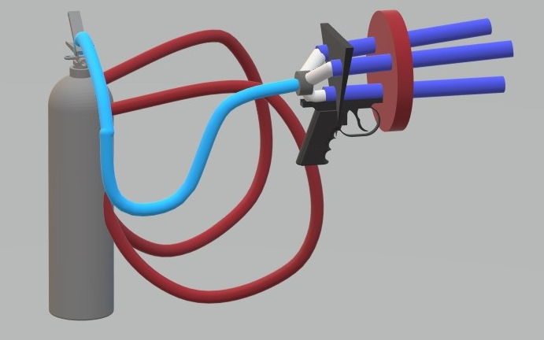
5) Seedlings devices
Air pressure pneumatics firing for seeds planting into the ground

Slide 20
NAVIGATION SYSTEM & CONTROLLER

Slide 21
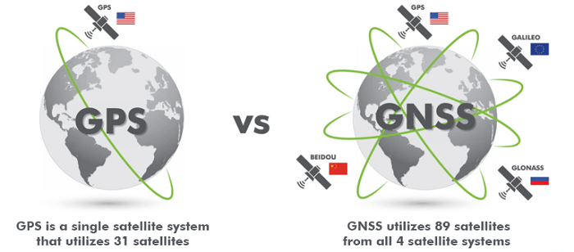
1) Global Navigation Satellite System (GNSS)
GNSS refers to a constellation of satellites providing signals from space that transmit positioning and timing data to GNSS receivers. The receivers then use this data to determine location.

Slide 22
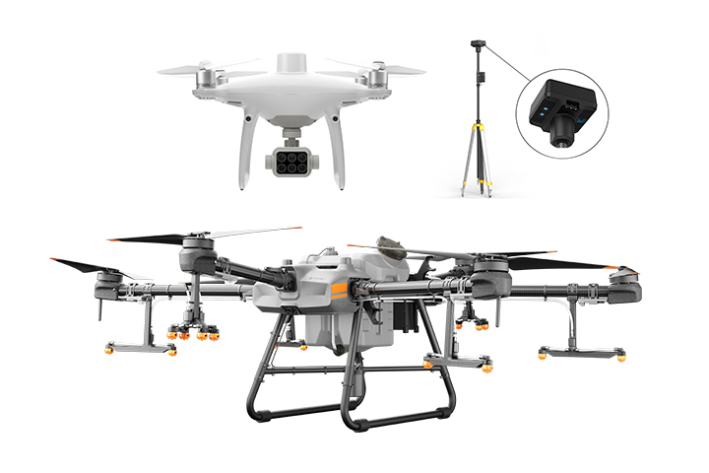
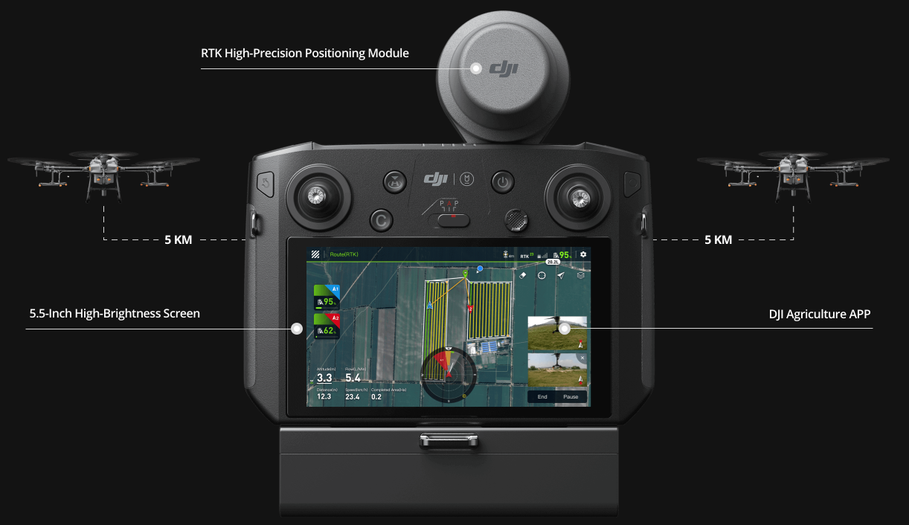
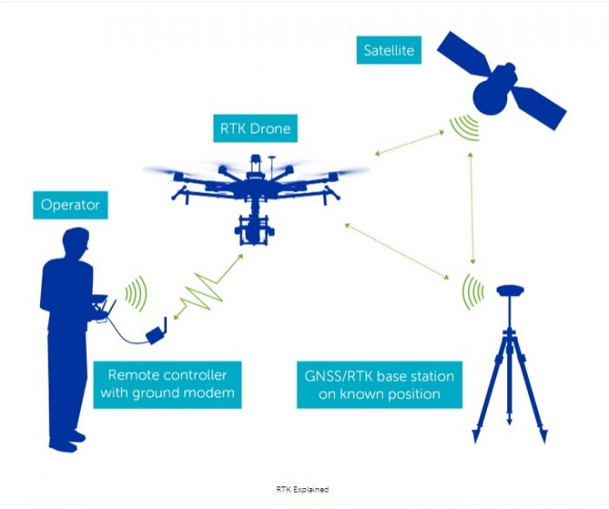
2) Real Time Kinematics (RTK) GPS
A technique that uses carrier-based ranging and provides ranges (and therefore positions) that are orders of magnitude more precise than those available through code-based positioning.

Slide 23
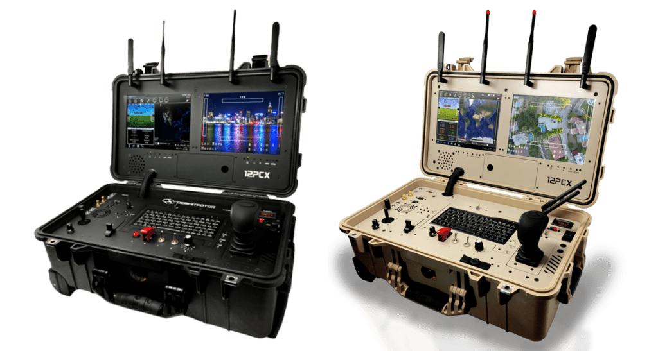
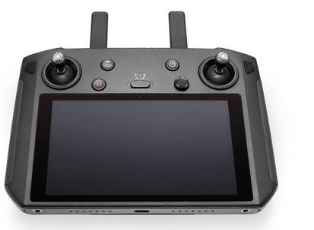
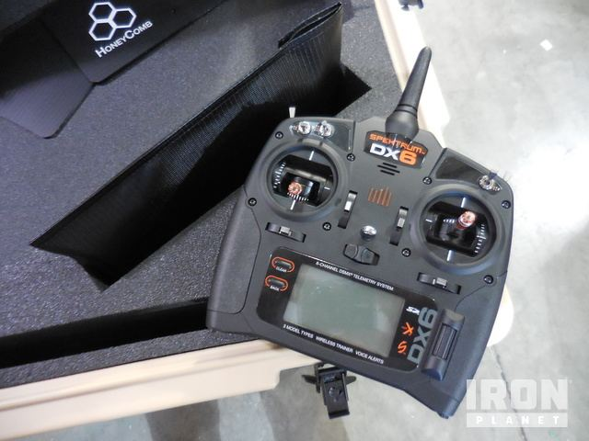
3) Controller
DJI Smart Controller
Model : RM500-ENT
Honeycomb AgDrone Controller
UAV ground station

Slide 24
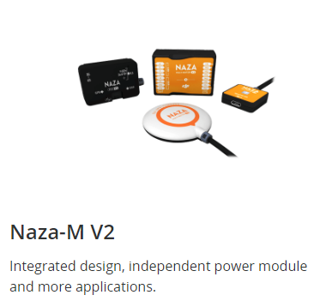
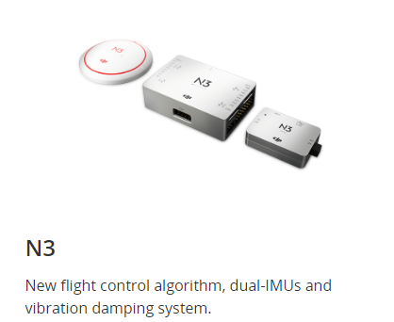
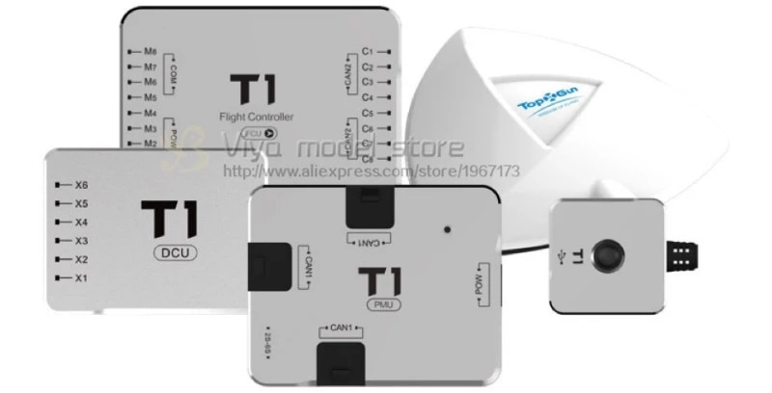
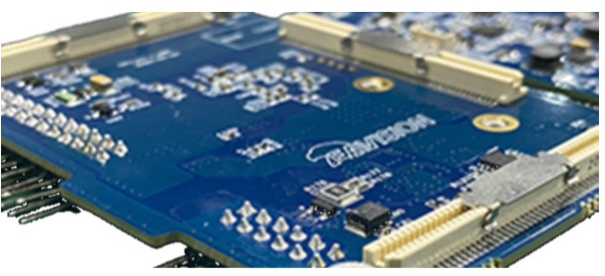
4) Flight controller with IMU
EA Pro Intelligent Control System
Automotive-grade CPU+GPU core processor, trillion-level floating-point computing capability per second, multi-threaded real-time parallel processing technology

Slide 25
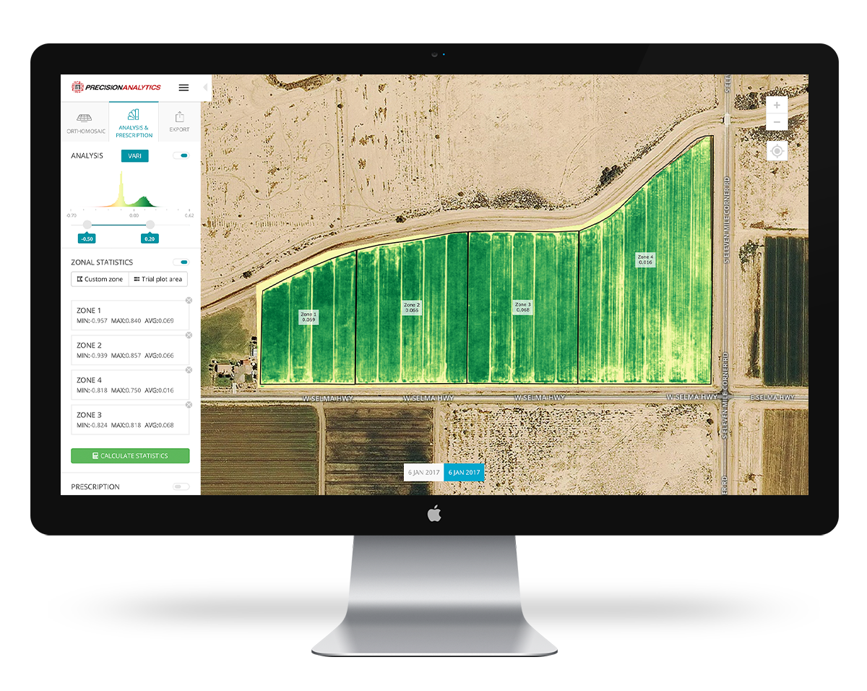
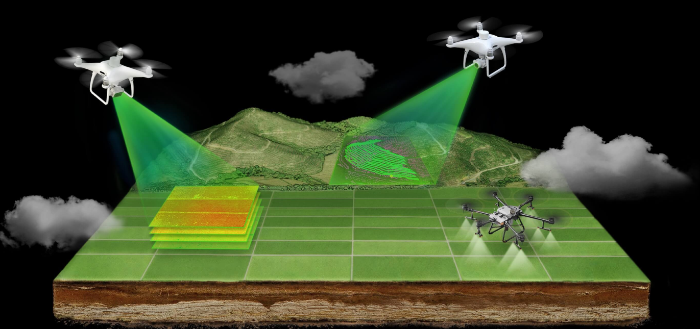
4) Precision Hawk Drone

Slide 26
DATA COLLECTION

Slide 27
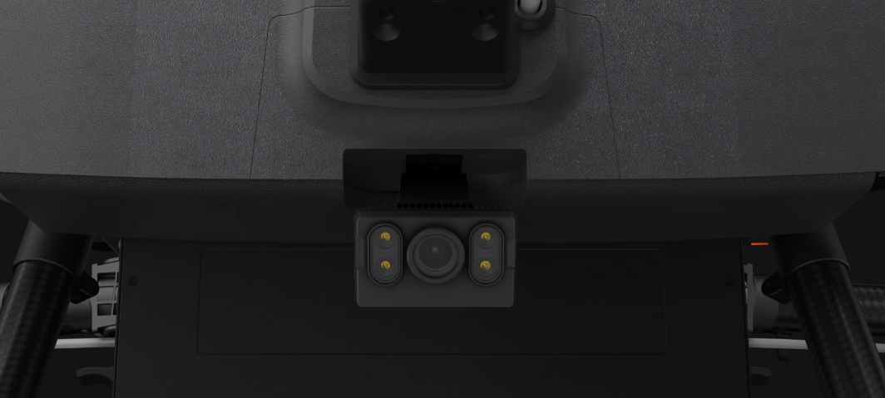
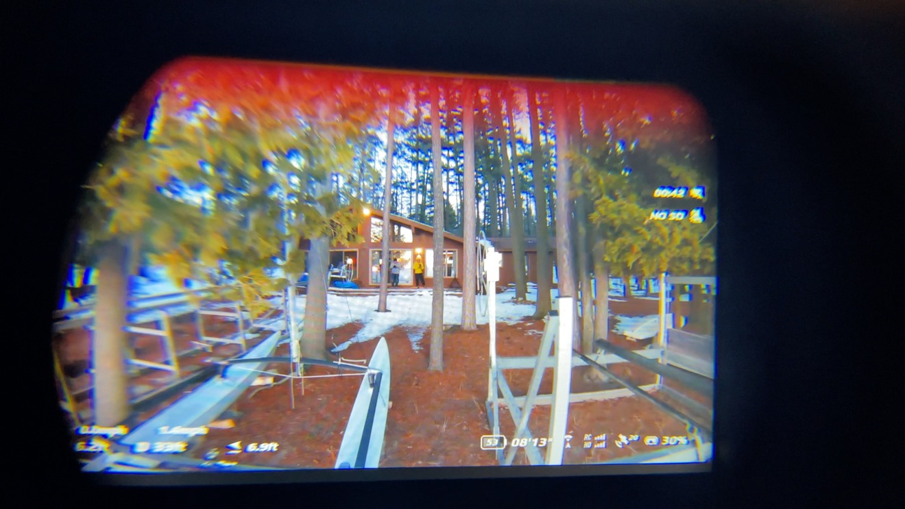
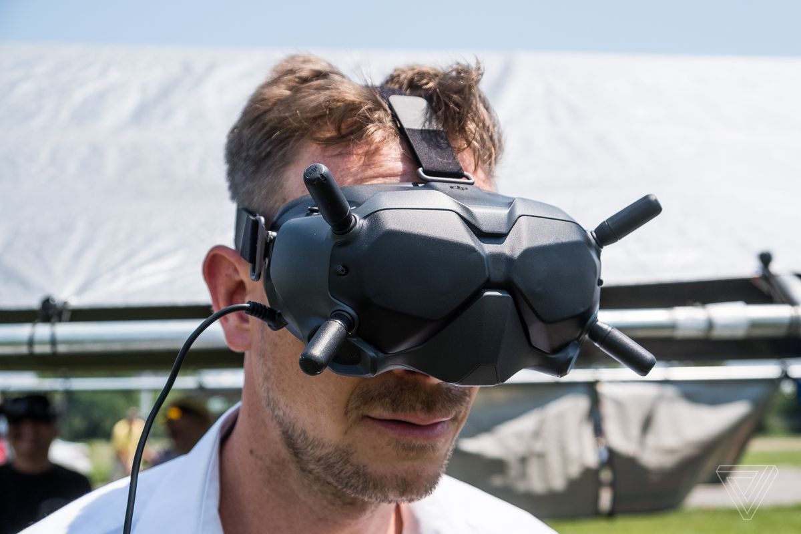
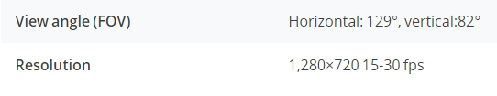
1) First Person View (FPV) Camera
Dual FPV cameras with night vision capabilities

Slide 28
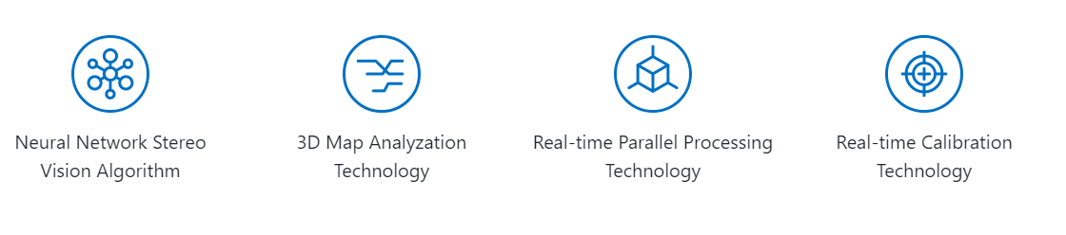
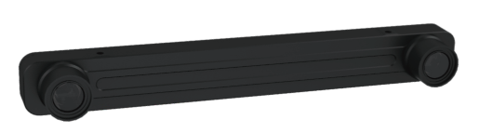
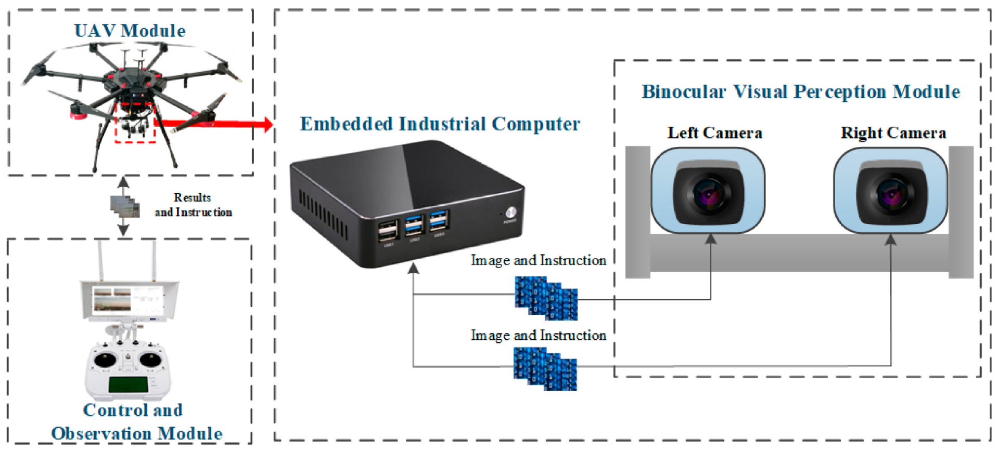
2) Binocular vision camera
Dual 4m pixels 120 wide angle pixel level recognition

Slide 29


3) Multispectral camera
Multispectral camera with sensors that feature for precise drone processing
Able to detect stressed and healthy areas

Slide 30




4) Radar system
Omnidirectional obstacle
avoidance radar
Model : RD2424R
Spherical radar system
Top view radar
Model : RD2414U

Slide 31


5) Lidar sensor
Lidar for drone mapping

Slide 32
DATA TRANSMISSION

Slide 33


1) Radio protocols
To remotely control the drone

Slide 34

2) Wireless connectivity

Slide 35


3) FPV module
Wirelessly connect between the drone and the controller
Connected via cable between the camera and the drone board

Slide 36
POWER SYSTEM MANAGEMENT

Slide 37




1) Flight battery with charger station
WB37 Intelligent battery for remote control
Model : BAX501

Slide 38


2) External smart battery charging
Remote control external smart battery
Model : WCH2
Power adapter
Model : A14-057N1A

Slide 39


3) SenseFLY battery
LiPo Battery 4900 mAh 11.1V
Battery charger

Slide 40

4) Honeycomb battery
Honeycomb 14s 20c 20000mah UAV high quality intelligent and efficient lithium battery

Slide 41
UAV COMPANY LOCALLY
Aerodyne - https://aerodyne.group/
Poladrone - https://www.poladrone.com/
Deftech - https://www.drb-hicom.com/group-companies/defence/
Avetics - https://www.avetics.com/
Vortex Edge - http://www.vortex-edge.com/
Dragonfly Robotix - https://www.dragonflyrobotix.com/
Centaurus Technology - https://www.centaurustechnology.com/

